Slide 1


Classification & Prediction of
Loan Defaulters
Team:
Richard Britto
Adarsh Lalchandani
Karthik Grandhi

Slide 2







Modeling Approach
Exploratory Data Analysis
Dimensionality Reduction & Variable Reduction
Clustering, Model Creating, Linear & Logistic
Analysis
of Models
Final Model Selection

Slide 3
Goal & Hypothesis
Goal: There exists some co-relation between the information we get from a user and the probability of that person to be defaulting with an outcome being either a defaulter or not a defaulter. We will perform analysis and develop a model by which we can classify & predict the defaulters and non defaulters

Slide 4
Research Question | Hypothesis | Null Hypothesis
How does the interest rates affect loan default rates? | Borrowers who have high interest rate are more likely to default than the borrowers with low interest rate | There is no relationship between the interest rate and probability to default
How is the borrower's debt to income ratio affecting their chances of defaulting? | Borrowers who have high debt to income ratio have high chances of defaulting thatn the borrowers with low debt to income ratio | There is no relationship between the borrower's debt to income ratio and the probability to default
Can the loan amount adjustments improve loan default rates? | Borrowers who have high loan amount are more likely to be charged off than the borrowers with low loan amount | There is no relationship between loan amount and probability to default
How does the borrower's annual income affect their chances of defaulting? | Borrower's having high annual income have less chances to default thant the borrowers having low or average income | There is no relationship between the borrower's annual income and the probability to default

Slide 5
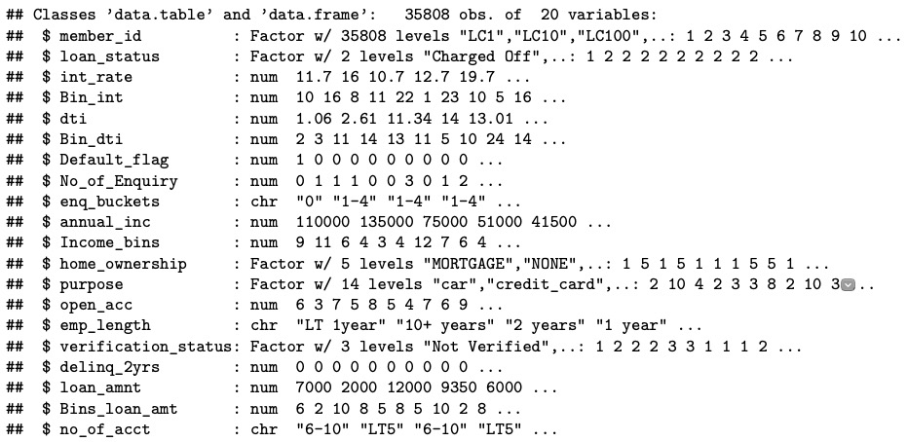
All about our Data

Slide 6
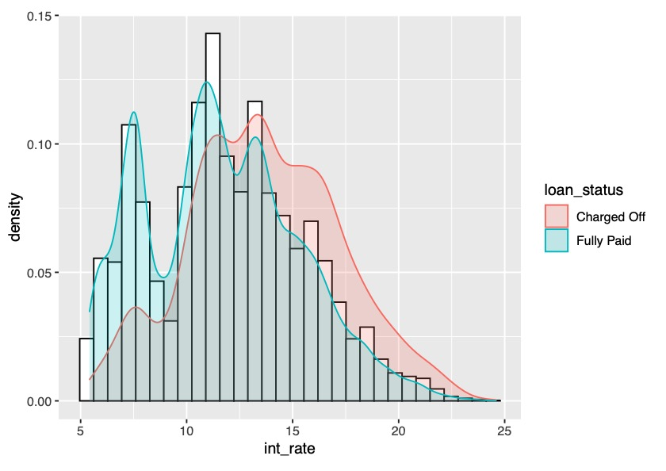
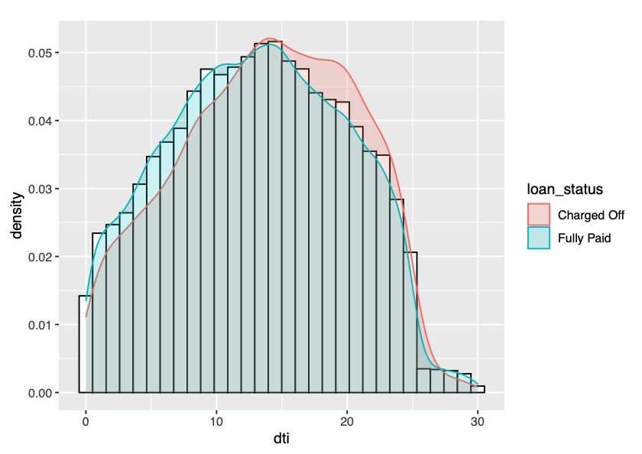
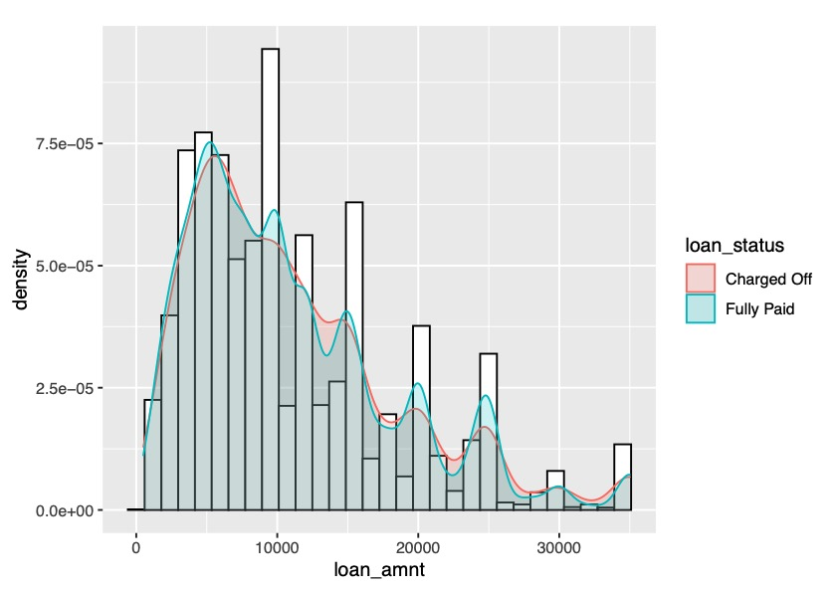
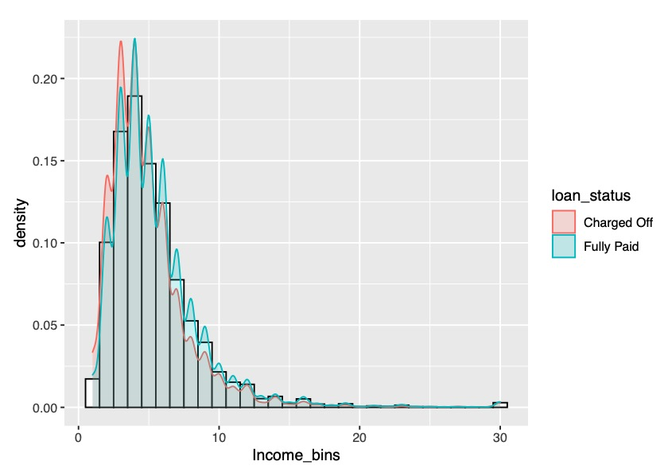
Exploratory Data Analysis

Slide 7
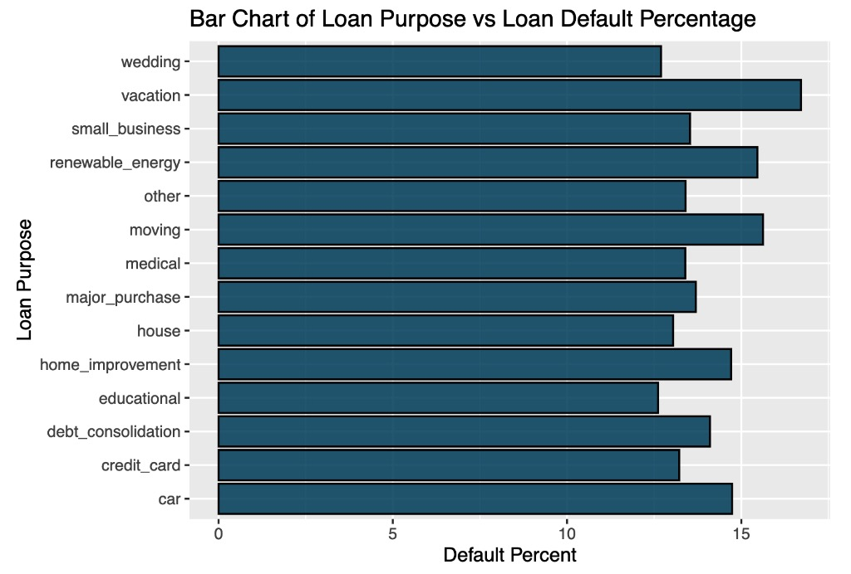
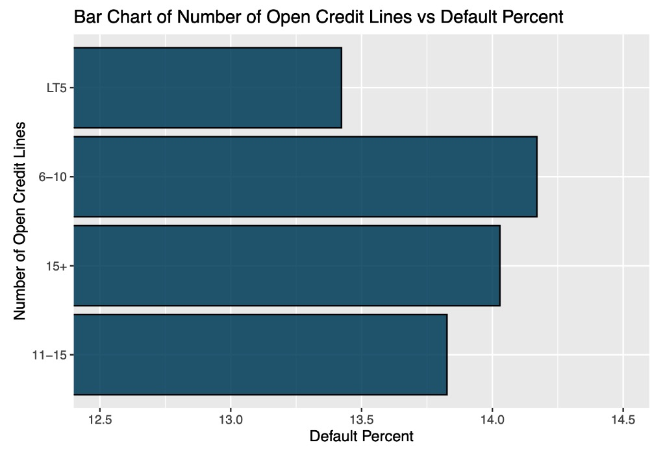
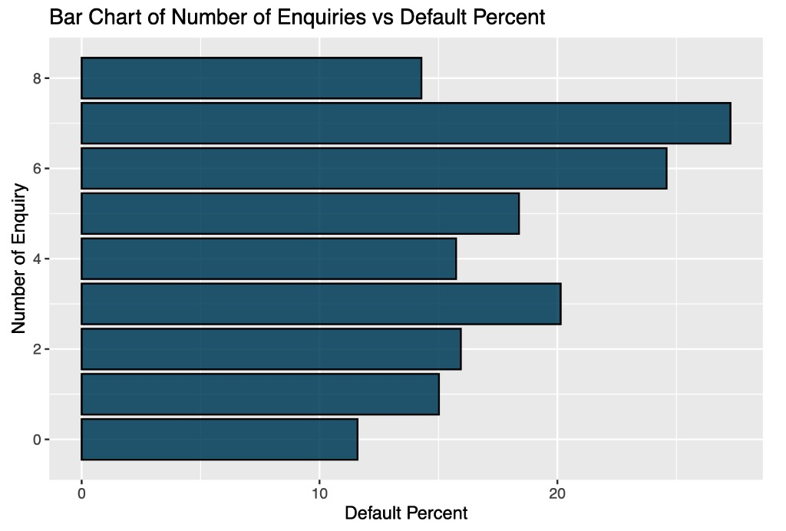
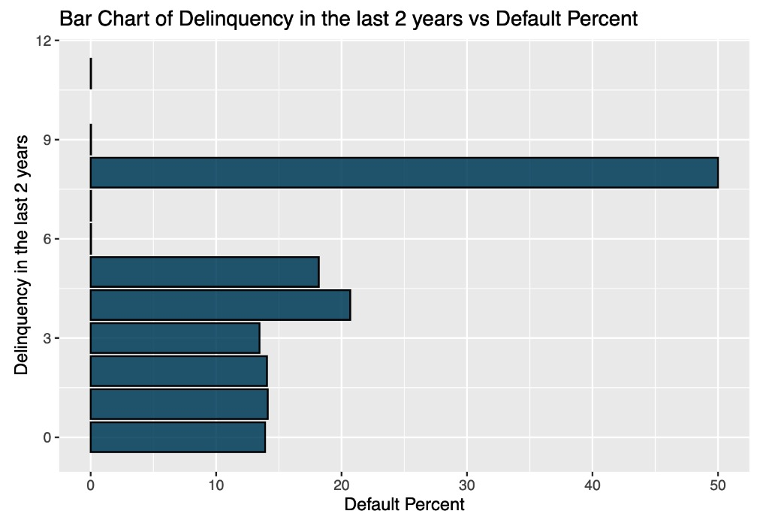
Exploratory Data Analysis

Slide 8
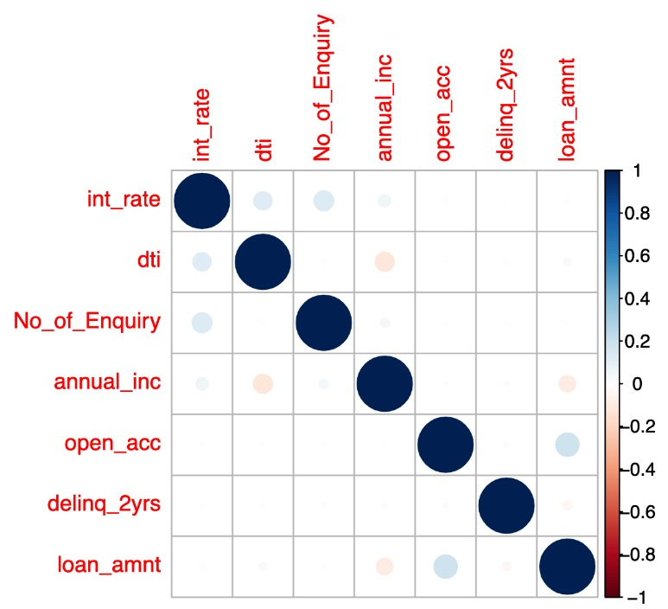
Correlation Plot
We can see the correlation of each variable to each other
Annual Income looks negatively correlated to debt to income ratio
Loan amount also looks negatively correlated to the annual income and have a slightly higher positive correlation with the number of open credit lines

Slide 9
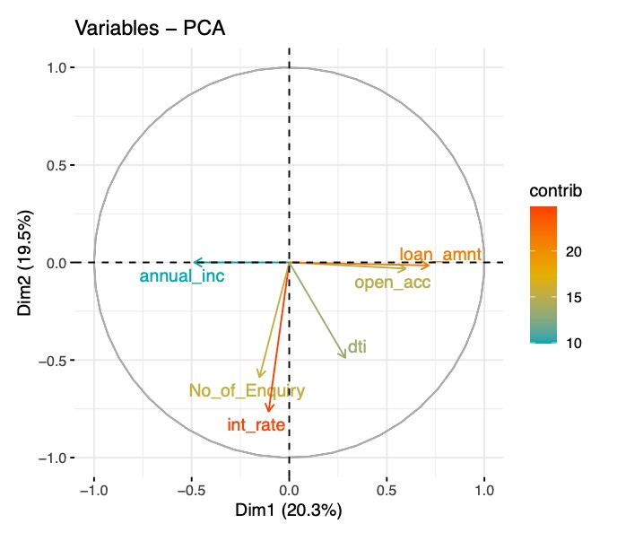
Principal Component Analysis
We can see the contribution of each variable for the first two dimensions, since PCA tries to contribute maximum variance in the initial dimensions
We observe high positive contribution of loan amount to dimension 1 and very less contribution in dimension 2
We see that annual income has a negative contribution to dimension 1 and no contribution to dimension 2
Interest rate has a strong negative contribution to dimension 2 and a slightly negative contribution to dimension 1

Slide 10
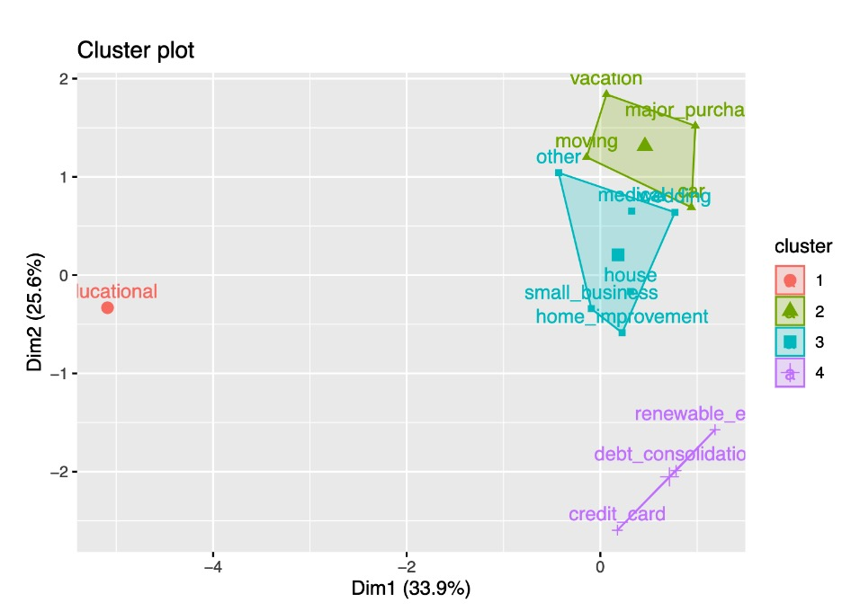
Clustering
We obtain 4 clusters when clustering over purpose for which the loan was taken
We can see that loan taken for education is completely isolated from the other purposes
We also observe the purple cluster to be different from the other clusters
Green cluster with vacation, moving, car, major purpose could have borrowers having similar profiles

Slide 11
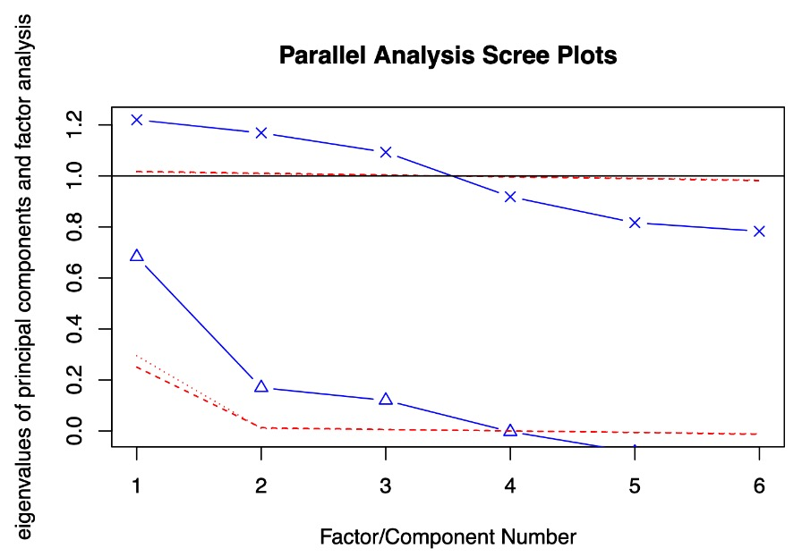
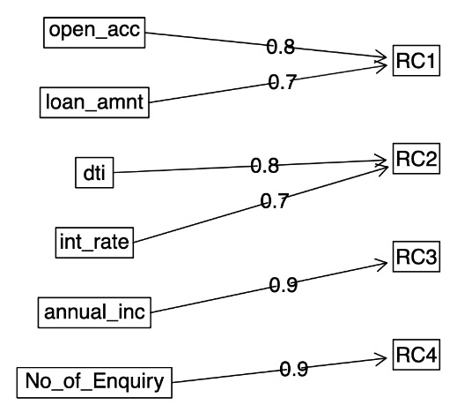
Factor Analysis
According to the left figure we can choose unto 3 Principal Components and unto 4 Factors

Slide 12
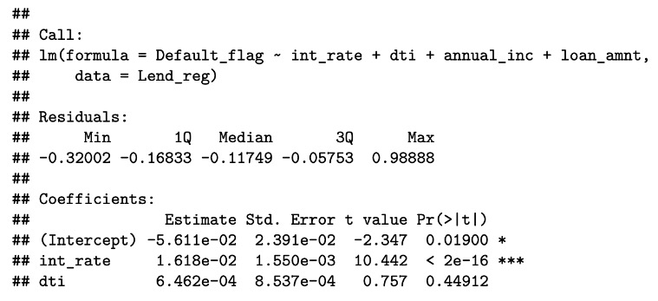
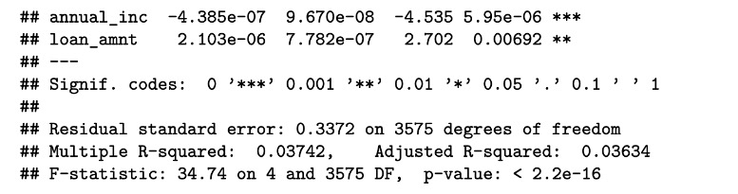
Multiple Linear Regression
Performing linear regression on categorical binary output
We get interest rate and annual income to be significantly influencing our model with a significance level of 0.001
We have a very low R-square which suggests that regression is not a good model for our data
Thought we got to know that interest rate and annual income are both positively and negatively driving our prediction respectively

Slide 13
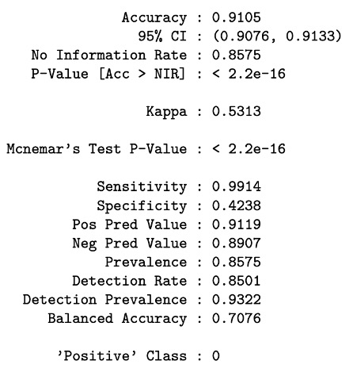
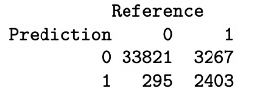
Logistic Regression
Statistics
We get an accuracy of 91.05% as we can see
P Value is very low which suggests that our logistic model is providing output which is statistically significant at a significance level of 0.05
Confusion Matrix

Slide 14
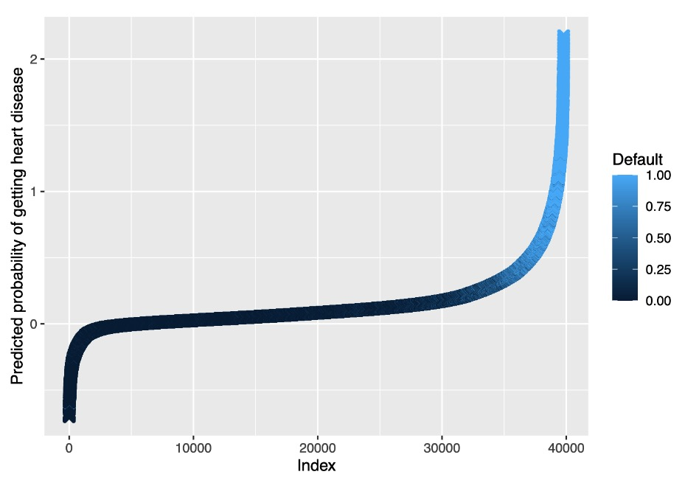
Predicted probability
The threshold value we have used is 0.5
So the predicted values below 0.5 are treated as Non-Defaulters
Further, the predicted values above 0.5 are treated as Defaulters
We can change the threshold value according to our need for recall and precision

Slide 15
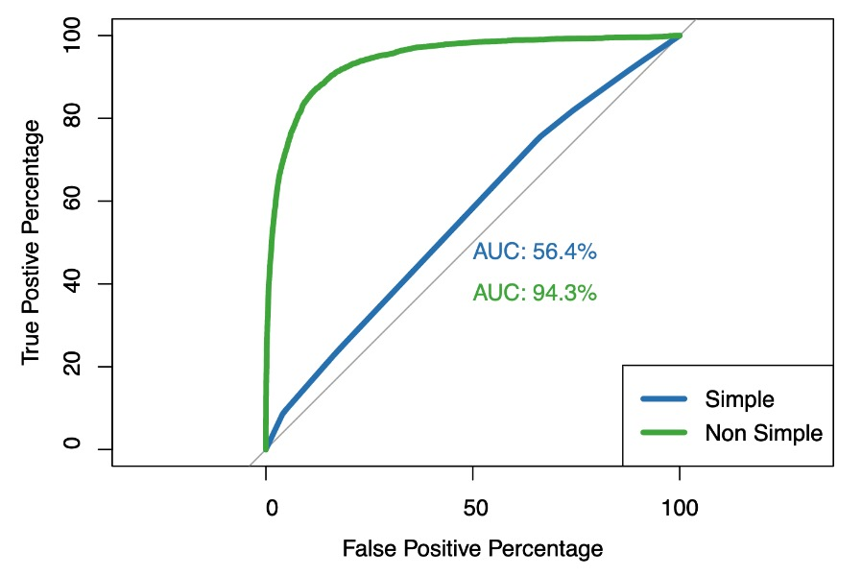
Receiver Operating Characteristics Curve (ROC)
Comparing the AUC for a simple logistic model that takes loan purpose as variable to a complex logistic regression that takes about 6 other variables along with purpose to classify defaulters
We see a significant difference in these two models from 56.4% AUC to 94.3% AUC
This clearly suggests us that the variables we ended up considering for our model are significantly improving our prediction

Slide 16
Conclusion
According to all our analysis we can make a conclusion of our hypothesis -
We can conclude that interest rate has a positive relation to a person being a defaulter and hence we reject the null hypothesis for interest rate
According to all our previous analysis we cannot conclude anything significant with the debt to income ratio and hence we fail to reject the null hypothesis for debt to income ratio
We also conclude with that the loan amount has a positive relation with a borrower defaulting and hence we reject the null hypothesis
We conclude with that annual income of a person has negative relation with a borrower defaulting and hence we reject the null hypothesis

Slide 17
Thank You

